Slide 1
Overview of JSP

Slide 2
What is JavaServer Pages?
JavaServer Pages (JSP) is a technology for developing Webpages that supports dynamic content.
This helps developers insert java code in HTML pages by making use of special JSP tags, most of which start with <% and end with %>.
Web developers write JSPs as text files that combine HTML or XHTML code, XML elements, and embedded JSP actions and commands.
Using JSP, you can collect input from users through Webpage forms, present records from a database or another source, and create Webpages dynamically.
JSP tags can be used for a variety of purposes, such as retrieving information from a database or registering user preferences, accessing JavaBeans components, passing control between pages, and sharing information between requests, pages etc.

Slide 3
Why Use JSP?
JavaServer Pages often serve the same purpose as programs implemented using the Common Gateway Interface (CGI). But JSP offers several advantages in comparison with the CGI.
  Performance is significantly better because JSP allows embedding Dynamic Elements in HTML Pages itself instead of having separate CGI files.
  JSP are always compiled before they are processed by the server unlike CGI/Perl which requires the server to load an interpreter and the target script each time the page is requested.
  JavaServer Pages are built on top of the Java Servlets API, so like Servlets, JSP also has access to all the powerful Enterprise Java APIs, including JDBC, JNDI, EJB, JAXP, etc.
  JSP pages can be used in combination with servlets that handle the business logic, the model supported by Java servlet template engines.

Slide 4
Setting up Web Server: Tomcat
A number of Web Servers that support JavaServer Pages and Servlets development are available in the market.
Some web servers can be downloaded for free and Tomcat is one of them.
Apache Tomcat is an open source software implementation of the JavaServer Pages and Servlet technologies and can act as a standalone server for testing JSP and Servlets, and can be integrated with the Apache Web Server.
Here are the steps to set up Tomcat on your machine −
Download the latest version of Tomcat from https://tomcat.apache.org/.
Once you downloaded the installation, unpack the binary distribution into a convenient location.
For example, in C:\apache-tomcat-5.5.29 on windows, or /usr/local/apache-tomcat-5.5.29 on Linux/Unix and create CATALINA_HOME environment variable pointing to these locations.

Slide 5
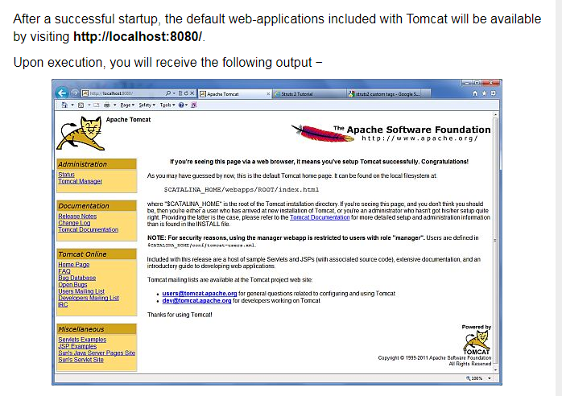

Slide 6
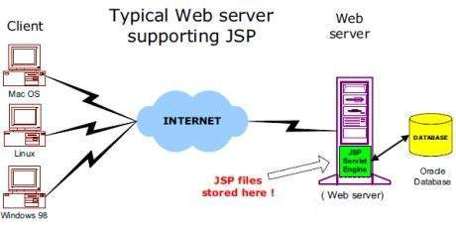
JSP - Architecture
The web server needs a JSP engine, i.e, a container to process JSP pages.
The JSP container is responsible for intercepting requests for JSP pages.
A JSP container works with the Web server to provide the runtime environment and other services a JSP needs.
It knows how to understand the special elements that are part of JSPs.
Following diagram shows the position of JSP container and JSP files in a Web application.

Slide 7
JSP Processing
The following steps explain how the web server creates the Webpage using JSP −
  As with a normal page, your browser sends an HTTP request to the web server.
  The web server recognizes that the HTTP request is for a JSP page and forwards it to a JSP engine.
    This is done by using the URL or JSP page which ends with .jsp instead of .html.
  The JSP engine loads the JSP page from disk and converts it into a servlet content.
    This conversion is very simple in which all template text is converted to println( ) statements and all JSP elements are converted to Java code.
  The JSP engine compiles the servlet into an executable class and forwards the original request to a servlet engine.
  A part of the web server called the servlet engine loads the Servlet class and executes it.
    During execution, the servlet produces an output in HTML format.
    The output is further passed on to the web server by the servlet engine inside an HTTP response.
  The web server forwards the HTTP response to your browser in terms of static HTML content.
  Finally, the web browser handles the dynamically-generated HTML page inside the HTTP response exactly as if it were a static page.

Slide 8
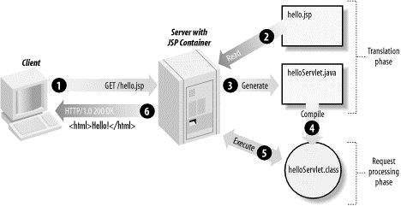

Slide 9
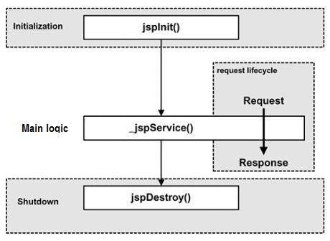
JSP - Lifecycle
The key to understanding the low-level functionality of JSP is to understand the simple life cycle they follow.
A JSP life cycle is defined as the process from its creation till the destruction.
The following are the paths followed by a JSP −
  Compilation
  Initialization
  Execution
  Cleanup

Slide 10
JSP Compilation
When a browser asks for a JSP, the JSP engine first checks to see whether it needs to compile the page.
If the page has never been compiled, or if the JSP has been modified since it was last compiled, the JSP engine compiles the page.
The compilation process involves three steps −
  Parsing the JSP.
  Turning the JSP into a servlet.
  Compiling the servlet.

Slide 11
JSP Initialization
When a container loads a JSP it invokes the jspInit() method before servicing any requests.
  public void jspInit()
  { // Initialization code... }
Typically, initialization is performed only once and as with the servlet init method, you generally initialize database connections, open files, and create lookup tables in the jspInit method.

Slide 12
JSP Execution
This phase of the JSP life cycle represents all interactions with requests until the JSP is destroyed.
Whenever a browser requests a JSP and the page has been loaded and initialized, the JSP engine invokes the _jspService() method in the JSP.
The _jspService() method takes an HttpServletRequest and an HttpServletResponse as its parameters as follows −
  void _jspService(HttpServletRequest request, HttpServletResponse response)
  { // Service handling code... }
The _jspService() method of a JSP is invoked on request basis.
  This is responsible for generating the response for that request and this method is also responsible for generating responses to all seven of the HTTP methods, i.e, GET, POST, DELETE, etc.

Slide 13
JSP Cleanup
The destruction phase of the JSP life cycle represents when a JSP is being removed from use by a container.
The jspDestroy() method is the JSP equivalent of the destroy method for servlets.
Override jspDestroy when you need to perform any cleanup, such as releasing database connections or closing open files.
The jspDestroy() method has the following form −
  public void jspDestroy()
  { // Your cleanup code goes here. }

Slide 14
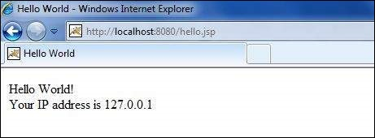
The Scriptlet
A scriptlet can contain any number of JAVA language statements, variable or method declarations, or expressions that are valid in the page scripting language.
Following is the syntax of Scriptlet −
  <% code fragment %>
Any text, HTML tags, or JSP elements you write must be outside the scriptlet.
Following is the simple and first example for JSP −
  <html>
  <head>
  <title>Hello World</title>
  </head>
  <body> Hello World!<br/>
  <% out.println("Your IP address is " + request.getRemoteAddr()); %> </body>
  </html>
Let us keep the above code in JSP file hello.jsp and put this file in C:\apache-tomcat7.0.2\webapps\ROOT directory.
Browse through the same using URL http://localhost:8080/hello.jsp. The above code will generate the following result −

Slide 15
JSP Declarations
A declaration declares one or more variables or methods that you can use in Java code later in the JSP file.
You must declare the variable or method before you use it in the JSP file.
Following is the syntax for JSP Declarations −
  <%! declaration; [ declaration; ]+ ... %>
Following is an example for JSP Declarations −
  <%! int i = 0; %>
  <%! int a, b, c; %>
  <%! Circle a = new Circle(2.0); %>

Slide 16
JSP Expression
A JSP expression element contains a scripting language expression that is evaluated, converted to a String, and inserted where the expression appears in the JSP file.
Because the value of an expression is converted to a String, you can use an expression within a line of text, whether or not it is tagged with HTML, in a JSP file.
The expression element can contain any expression that is valid according to the Java Language Specification but you cannot use a semicolon to end an expression.
Following is the syntax of JSP Expression −
  <%= expression %>
Following example shows a JSP Expression −
  <html>
  <head>
  <title>A Comment Test</title>
  </head>
  <body>
  <p>Today's date: <%= (new java.util.Date()).toLocaleString()%></p>
  </body>
  </html>
The above code will generate the following result −
  Today's date: 11-Sep-2010 21:24:25

Slide 17
JSP Comments
JSP comment marks text or statements that the JSP container should ignore.
A JSP comment is useful when you want to hide or "comment out", a part of your JSP page.
Following is the syntax of the JSP comments −
  <%-- This is JSP comment --%>
Following example shows the JSP Comments −
  <html>
  <head>
  <title>A Comment Test</title>
  </head>
  <body><h2>A Test of Comments</h2>
  <%-- This comment will not be visible in the page source --%> </body>
  </html>
The above code will generate the following result −
  A Test of Comments

Slide 18
JSP Implicit Objects
S.No. | Object & Description
1 | request This is the HttpServletRequest object associated with the request.
2 | response This is the HttpServletResponse object associated with the response to the client.
3 | out This is the PrintWriter object used to send output to the client.
4 | session This is the HttpSession object associated with the request.
5 | application This is the ServletContext object associated with the application context.
6 | config This is the ServletConfig object associated with the page.
7 | pageContext This encapsulates use of server-specific features like higher performance JspWriters.
8 | page This is simply a synonym for this, and is used to call the methods defined by the translated servlet class.
9 | Exception The Exception object allows the exception data to be accessed by designated JSP.

Slide 19
JSP - Client Request
When a browser requests for a Webpage, it sends a lot of information to the web server.
This information cannot be read directly because this information travels as a part of header of HTTP request.
Following table lists out the important header information which comes from the browser.

Slide 20
S.No. | Header & Description
1 | Accept This header specifies the MIME types that the browser or other clients can handle. Values of image/png or image/jpeg are the two most common possibilities.
2 | Accept-Charset This header specifies the character sets that the browser can use to display the information. For example, ISO-8859-1.
3 | Accept-Encoding This header specifies the types of encodings that the browser knows how to handle. Values of gzip or compress are the two most common possibilities.
4 | Accept-Language This header specifies the client's preferred languages in case the servlet can produce results in more than one language. For example en, en-us, ru, etc.
5 | Authorization This header is used by clients to identify themselves when accessing password-protected webpages.
6 | Connection This header indicates whether the client can handle persistent HTTP connections. Persistent connections permit the client or other browser to retrieve multiple files with a single request. A value of Keep-Alive means that persistent connections should be used.
7 | Content-Length This header is applicable only to POST requests and gives the size of the POST data in bytes.
8 | Cookie This header returns cookies to servers that previously sent them to the browser.
9 | Host This header specifies the host and port as given in the original URL.
10 | If-Modified-Since This header indicates that the client wants the page only if it has been changed after the specified date. The server sends a code, 304 which means Not Modified header if no newer result is available.
11 | If-Unmodified-Since This header is the reverse of If-Modified-Since; it specifies that the operation should succeed only if the document is older than the specified date.
12 | Referer This header indicates the URL of the referring webpages. For example, if you are at Webpage 1 and click on a link to Webpage 2, the URL of Webpage 1 is included in the Referer header when the browser requests Webpage 2.
13 | User-Agent This header identifies the browser or other client making the request and can be used to return different content to different types of browsers.

Slide 21
The HttpServletRequest Object
The request object is an instance of a javax.servlet.http.HttpServletRequest object.
Each time a client requests a page, the JSP engine creates a new object to represent that request.
The request object provides methods to get HTTP header information including form data, cookies, HTTP methods, etc.
Following table lists out the important methods that can be used to read HTTP header in your JSP program.
These methods are available with HttpServletRequest object which represents client request to webserver.

Slide 22
S.No. | Method & Description
1 | Cookie[] getCookies() Returns an array containing all of the Cookie objects the client sent with this request.
2 | Enumeration getAttributeNames() Returns an Enumeration containing the names of the attributes available to this request.
3 | Enumeration getHeaderNames() Returns an enumeration of all the header names this request contains.
4 | Enumeration getParameterNames() Returns an enumeration of String objects containing the names of the parameters contained in this request.
5 | HttpSession getSession() Returns the current session associated with the this request, or if the request does not have a session, creates one.
6 | HttpSession getSession(boolean create) Returns the current HttpSession associated with the this request or, if if there is no current session and create is true, returns a new session.
7 | Locale getLocale() Returns the preferred Locale that the client will accept content in, based on the Accept-Language header.
8 | Object getAttribute(String name) Returns the value of the named attribute as an Object, or null if no attribute of the given name exists.
9 | ServletInputStream getInputStream() Retrieves the body of the request as binary data using a ServletInputStream.
10 | String getAuthType() Returns the name of the authentication scheme used to protect the servlet, for example, "BASIC" or "SSL," or null if the JSP was not protected.
11 | String getCharacterEncoding() Returns the name of the character encoding used in the body of this request.
12 | String getContentType() Returns the MIME type of the body of the request, or null if the type is not known.
13 | String getContextPath() Returns the portion of the request URI that indicates the context of the request.

Slide 23
JSP - Server Response
When a Web server responds to a HTTP request, the response typically consists of a status line, some response headers, a blank line, and the document.
A typical response looks like this −
  HTTP/1.1 200 OK
  Content-Type: text/html
  Header2: ... ... HeaderN:
  ... (Blank Line)
  <!doctype ...>
  <html>
  <head>...</head>
  <body> ... </body>
  </html>
The status line consists of the HTTP version (HTTP/1.1 in the example), a status code (200 in the example), and a very short message corresponding to the status code (OK in the example).

Slide 24
Following table lists out the HTTP status codes and associated messages that might be returned from the Web Server −
Code | Message | Description
100 | Continue | Only a part of the request has been received by the server, but as long as it has not been rejected, the client should continue with the request
101 | Switching Protocols | The server switches protocol.
200 | OK | The request is OK
201 | Created | The request is complete, and a new resource is created
202 | Accepted | The request is accepted for processing, but the processing is not complete.
203 | Non-authoritative Information
204 | No Content
205 | Reset Content
206 | Partial Content
300 | Multiple Choices | A link list; the user can select a link and go to that location. Maximum five addresses.
301 | Moved Permanently | The requested page has moved to a new url.
302 | Found | The requested page has moved temporarily to a new url.
303 | See Other | The requested page can be found under a different url.
304 | Not Modified
305 | Use Proxy
306 | Unused | This code was used in a previous version. It is no longer used, but the code is reserved.

Slide 25
JSP - Form Processing
You must have come across many situations when you need to pass some information from your browser to the web server and ultimately to your backend program.
The browser uses two methods to pass this information to the web server.
These methods are the GET Method and the POST Method.

Slide 26
GET method
The GET method sends the encoded user information appended to the page request.
The page and the encoded information are separated by the ? character as follows −
  http://www.test.com/hello?key1=value1&key2=value2
The GET method is the default method to pass information from the browser to the web server and it produces a long string that appears in your browser's Location:box.
The GET method has size limitation: only 1024 characters can be in a request string.
This information is passed using QUERY_STRING header and will be accessible through QUERY_STRING environment variable which can be handled using getQueryString() and getParameter() methods of request object.

Slide 27
POST method
A generally more reliable method of passing information to a backend program is the POST method.
This method packages the information in exactly the same way as the GET method, but instead of sending it as a text string after a ? in the URL it sends it as a separate message.
This message comes to the backend program in the form of the standard input which you can parse and use for your processing.
JSP handles this type of requests using getParameter() method to read simple parameters and getInputStream() method to read binary data stream coming from the client.

